Slide 1
Stage 3: Researching consumer preferences

Slide 2
Learning Objectives:
To design and conduct a survey
To present data in a pictogram
Market research is used by grown-up businesses to help them find out what their customers need and like.
We can use it to find which flavour of bread our customers would prefer.
Why do you think we need this information?

Slide 3
Market Research
For our survey, we need to ask a short question that can only be answered by selecting one of the possible answers.
For example, which flavour of bread would you prefer? Tomato and basil or cheese and parsley?
By asking our participants to choose the food product option they would like the most out of your ideas, we will be able to decide if people will want to buy our products or not. This will help us make a final decision about what to make.

Slide 4
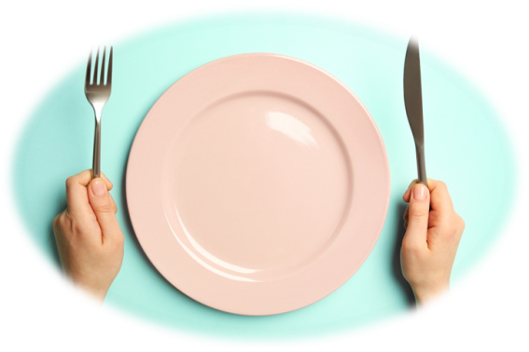
Task 1: decide on your flavours
With your group, brainstorm at least 4 ideas for healthy flavours you could add to your bread, in addition to the herbs you are growing.
Use the recipe books and the internet to inspire you!
Think about how you could make your food product stand out from the crowd. This is your unique selling point.

Slide 5
Task 2: Collecting data
Write your research question. For example: Which flavour of bread is the most popular with children in our class?
Ask as many children as possible and record your results using a tally chart.
Think about your Year 2 learning: what is a tally chart?

Slide 6
Tally charts
Bread flavour | Tally
Tomato and basil
Onion and basil
Cheese and parsley
Lemon and parsley
2. Each time someone votes for a flavour, make a tally mark in the tally column.
For your fifth tally mark, draw your line through your first 4 tally marks.
1. Draw a table with 2 columns. One is for your bread flavour ideas and the other is for how many children voted for them.

Slide 7
Task 3: Chocolate bar challenge!
Fill one of the squares on your chocolate box with a fact that you can remember about pictograms from Year 2.
Move around the room and collect facts from your friends. When they tell you their fact, you must give them your fact and both of you can then add your new facts to your chocolate boxes.
Continue to swap facts with your classmates until your chocolate bar is full of delicious pictogram facts!
3. Add a key.

Slide 8
Task 3: Drawing a pictogram
Bread flavour | Number of votes
Tomato and basil
Onion and basil
Cheese and parsley
Lemon and parsley
Key:
=2
2. Draw 1 symbol for every 2 people who voted for each flavour.
1. Draw a table with 2 columns. One is for your bread flavour ideas and the other is for how many children voted for them.
3. Add a key.
4. How can we show an odd number of votes?
5. How many children voted for each flavour?

Slide 9
Task 4: Making your final decision
Discuss your results with your business group and make a final decision about the flavoured bread that you will produce.

